Slide 1
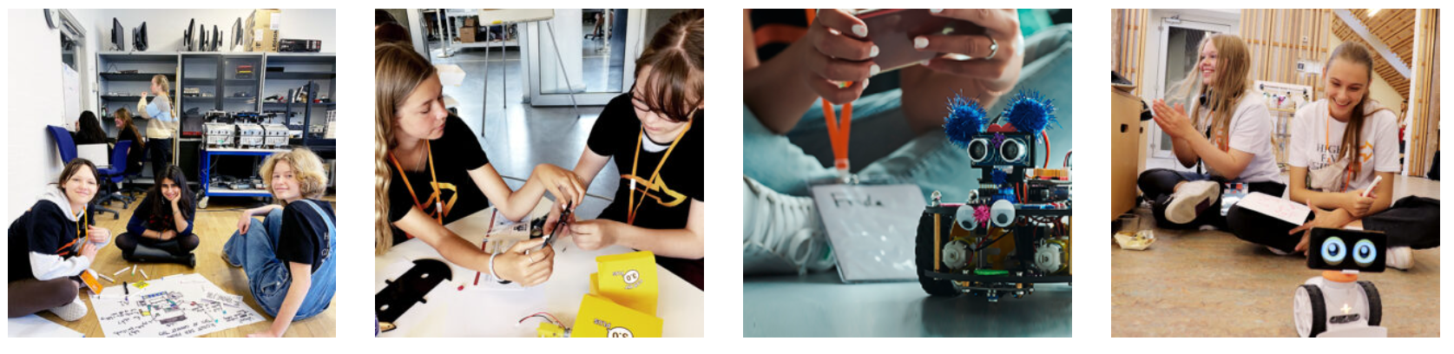
Go-to Science
Group 4: Anne Mia, Christian, Mads, Rikke, Sebastian, Simone, Tobias
Notes:
1-2-3 Simone
4 Rikke
5 Mads
6 AM
789 Tobias
10-11 Christian
12-13 Sebastian

Slide 2
🔍 Problem & Purpose

Slide 3
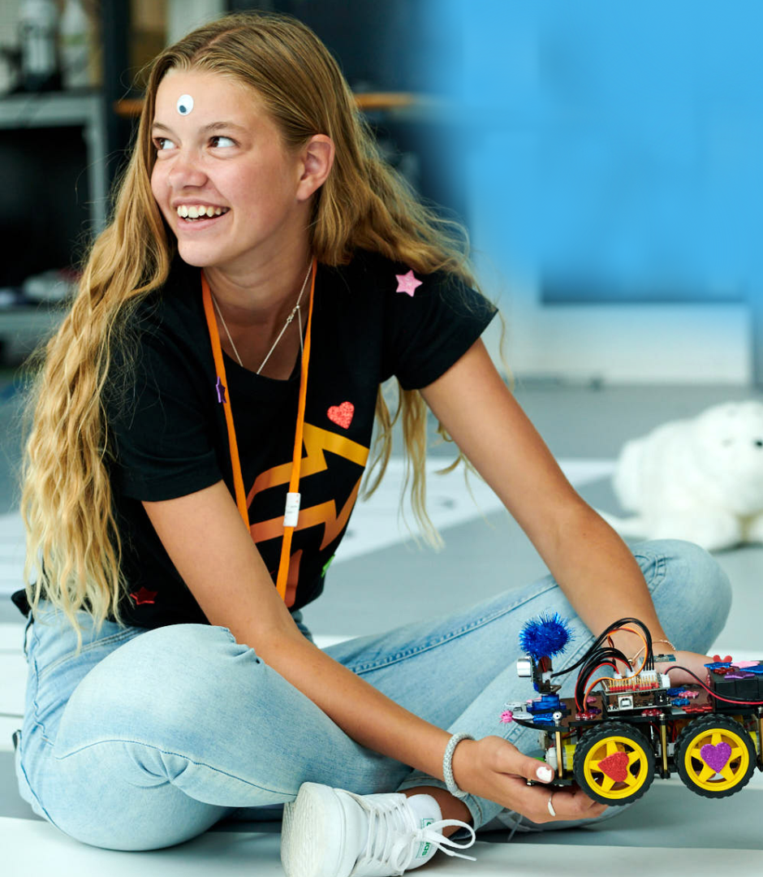
Executive Summary
High5Girls After-School Event Series
🎯 Goal: Hands-on STEM learning for girls (13–16)
🤖 Focus: Robotics with Arduino & electronics
👩‍🔬 Role Models: Female STEM role models
🌱 Impact: Build skills, spark curiosity, grow confidence
Pilot completed — positive feedback & high interest!
Notes:
Simone
“Hi, I’m Simone, and this project was developed through the High5Girls initiative. It addresses the under-representation of women in STEM by offering after-school sessions focused on hands-on science—in this case, robotics—for girls aged 13–16.
We combine accessible tech learning with mentorship from female role models, fostering curiosity, skills, and confidence. Our goal is long-term interest in STEM through fun, supportive environments.”

Slide 4
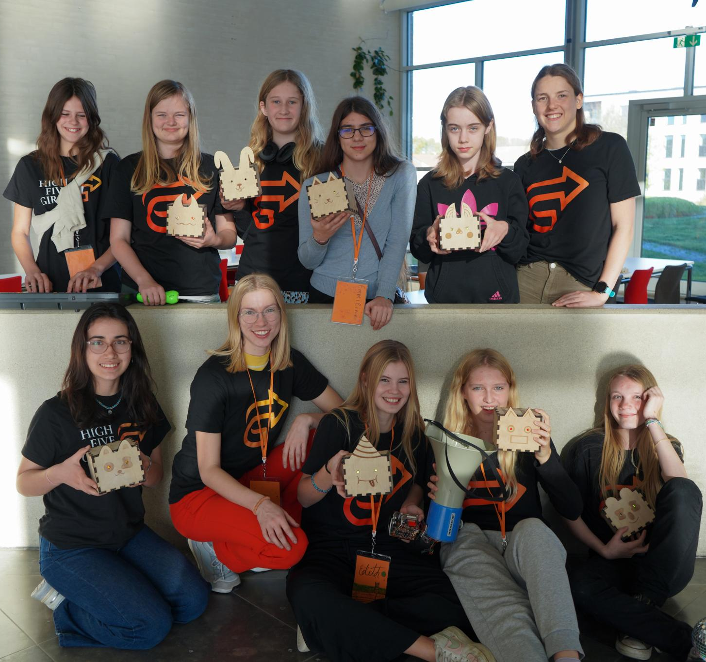
Project Description
Why It Matters
Girls are underrepresented in STEM
Early engagement makes a difference
Our events feel like sports or music lessons — just STEM
What We Face
🎯 Reaching participants
🔄 Scaling sustainably
📦 Managing logistics
Where We Are
🧪 Pilot done
🔧 Ongoing development
📊 Evaluation & feedback in progress
Notes:
“The project is designed like an extracurricular program—like sports or music lessons—but focused on science and tech. Sessions are co-created with robotics engineers and feature interactive content that’s both educational and fun.
We’re based in Odense, free to attend, and supported by sponsors and volunteers. Our model is low-cost but high-impact. Of course, we face some challenges—like attracting participants and managing logistics—but we’ve planned ahead through community outreach and structured resource management.
We’ve already piloted one event series, and feedback was very positive. Now we’re refining and scaling up.”

Slide 5
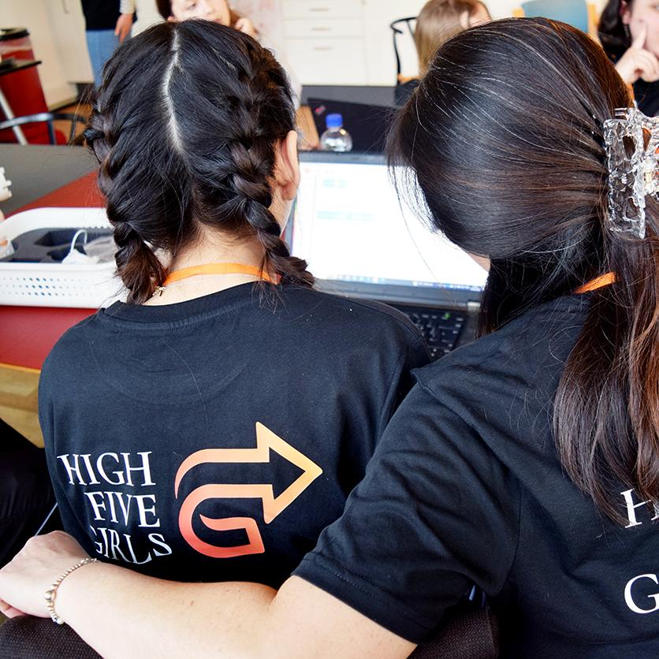
Key numbers
Audience & Partners
👧 Girls 13–16
👥 Engineers, schools, & community orgs
Timeline
🗓️ 3 months planning
⏱️ 5 weeks execution
Budget
💰 25,000 DKK per series
🤝 Funded by sponsors
Goal
📈 80% positive feedback = scale to more STEM topics & cities
Notes:
Simone
“Our target group is girls aged 13 to 16. We work closely with engineering students, schools, and community centers. It takes around 3 months to plan a series, and 5 weeks to run it.
Each series costs around 25,000 DKK, fully funded by sponsors. That covers everything—from materials to snacks. We’re gathering feedback and aim for 80% positive responses. If that holds, we have a model we can replicate and expand.”

Slide 6
📚 How We Delivered It

Slide 7
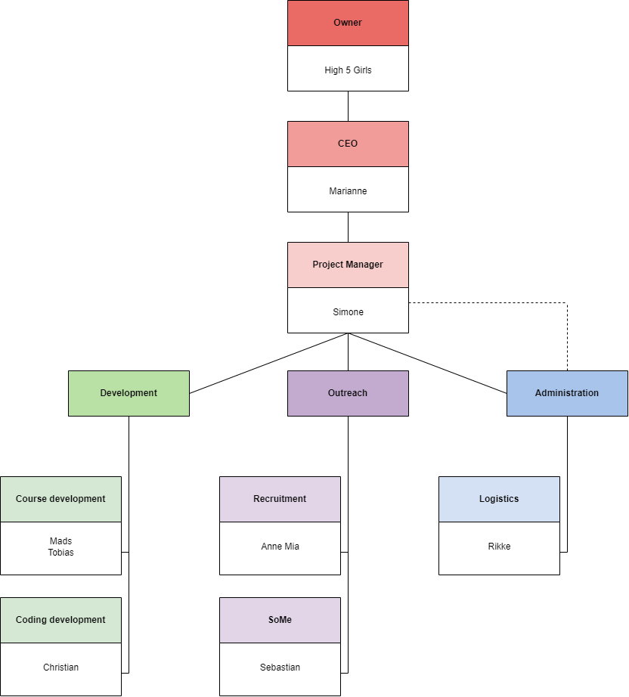
Organizational Structure
Illustrates the project’s structure
Personality assessment
Development:
Mads & Tobias: Detail-oriented
Christian: Analytical
Outreach:
Anne Mia & Sebastian: Empathic
Administration
Rikke: Strategic
Simone: Efficient
Notes:
Rikke The organizational diagram below illustrates the project’s structure, dividing tasks into three key branches: course development, outreach (encompassing recruitment, marketing, and social media), and administration (responsible for funding, planning, and coordination).
To maximize individual contributions and foster effective collaboration within this newly formed team, personality assessments were utilized to guide role assignments.

Slide 8
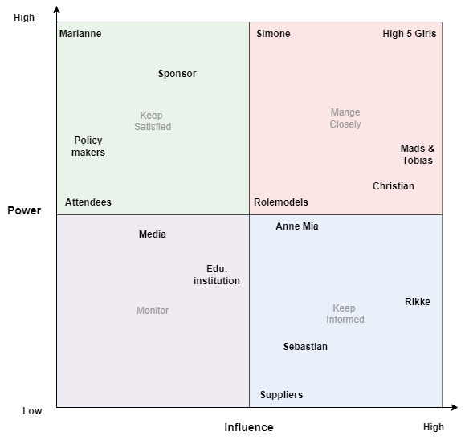
Stakeholders
Power influence grid → Categorizes stakeholders
Considerations Factors:
Power
Formal authority
Control over resources
Information access
Influence
Persuasion skills
Networks
Reputation
Engagement assessment of stakeholders
Notes:
Rikke ”Keep satisfied” category hold high power but low influence, so these should stay informed but don’t shape the content.
”Manage closely” includes those with both high power and influence, involved in course development and decision making.
”Monitor” includes those minimally affected by the project and only require occasional updates.
”Keep informed” applies to those with low power but high influence. These are key to logistics and execution, though not final decision-makers.
to guide engagement strategy and ensure team focus

Slide 9
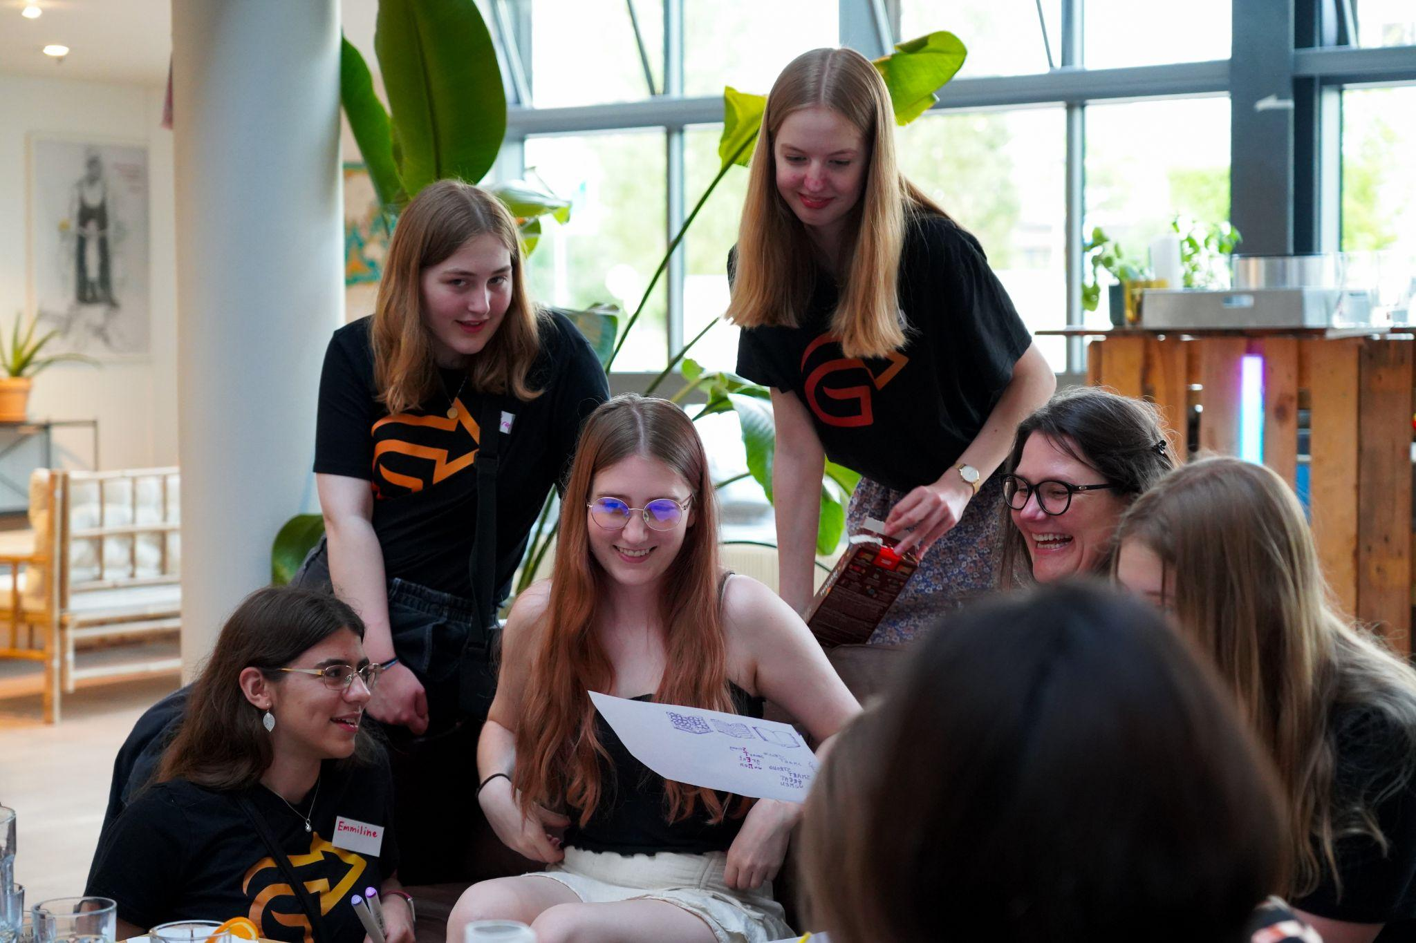
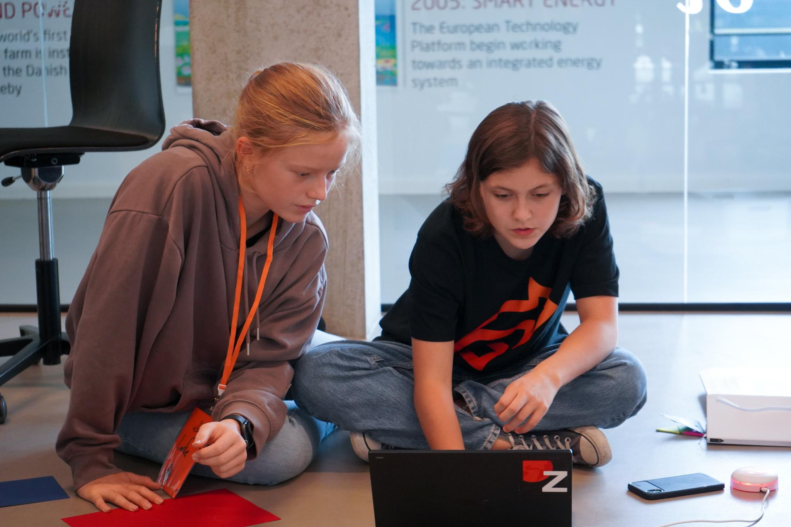
Project scope
Project purpose
“Addressing the under-representation of women in STEM”
Project Goals
Scope description
Design course
Execute course
Key milestones
Constraints
Notes:
Mads
Project scope is a way to set boundaries on your project and define exactly what goals, deadlines, and project deliverables …
FUNDING
volunteering
project deliverables
scope creep

Slide 10
📊 How We Managed It

Slide 11
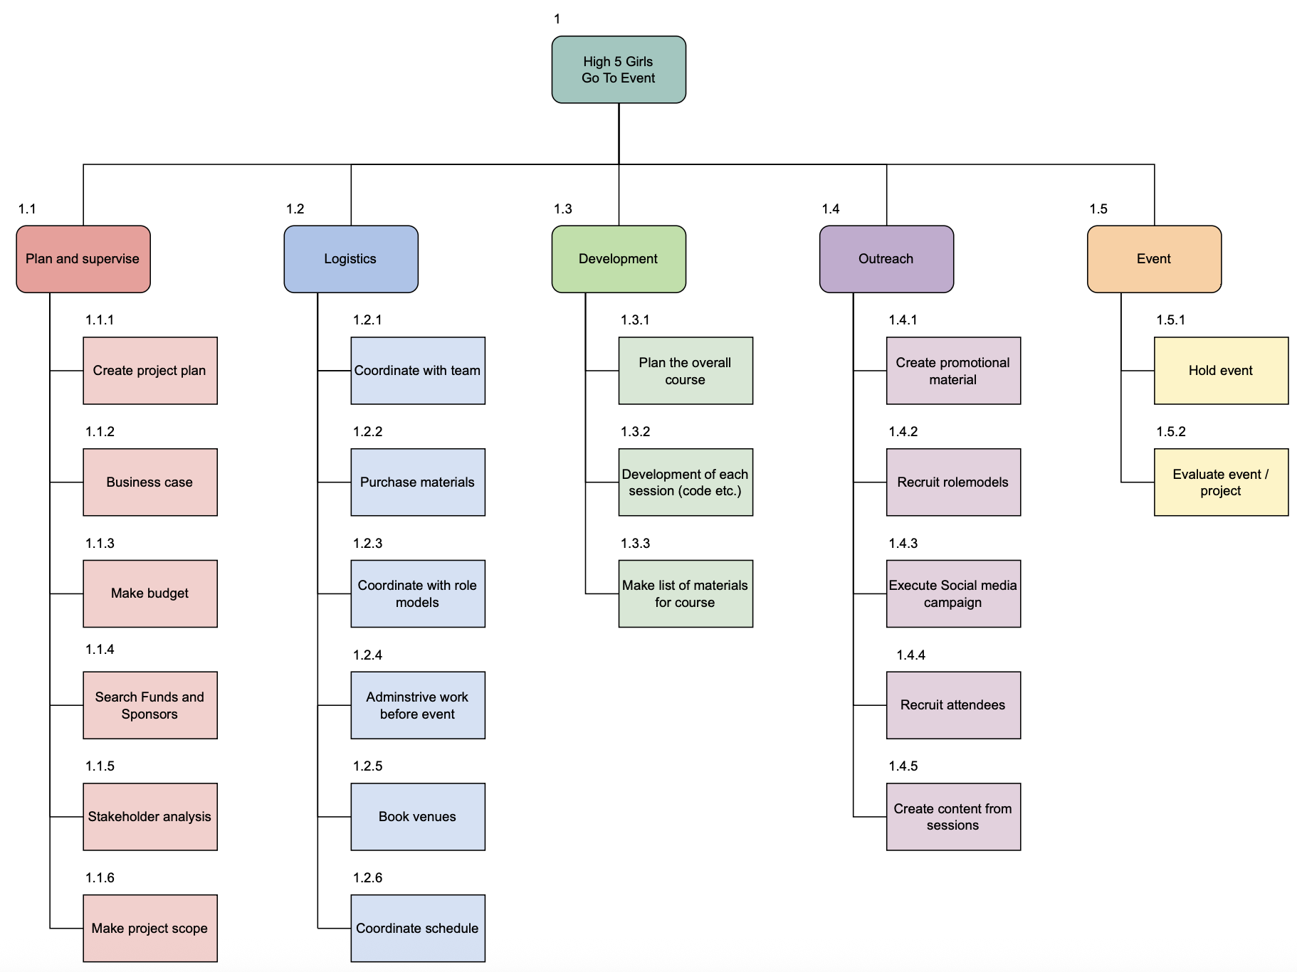
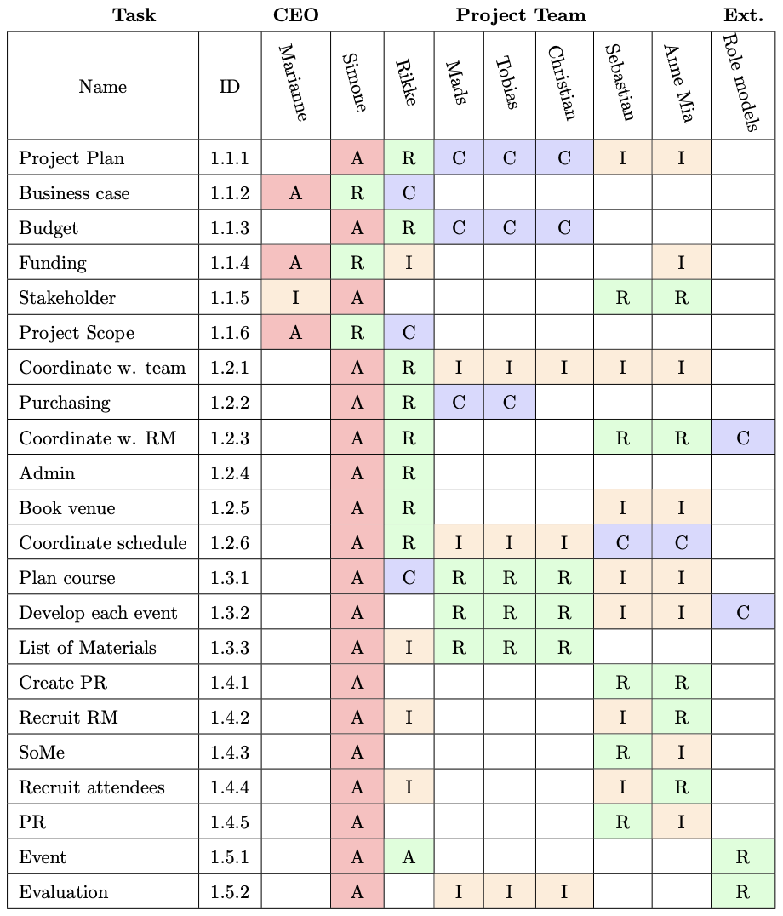
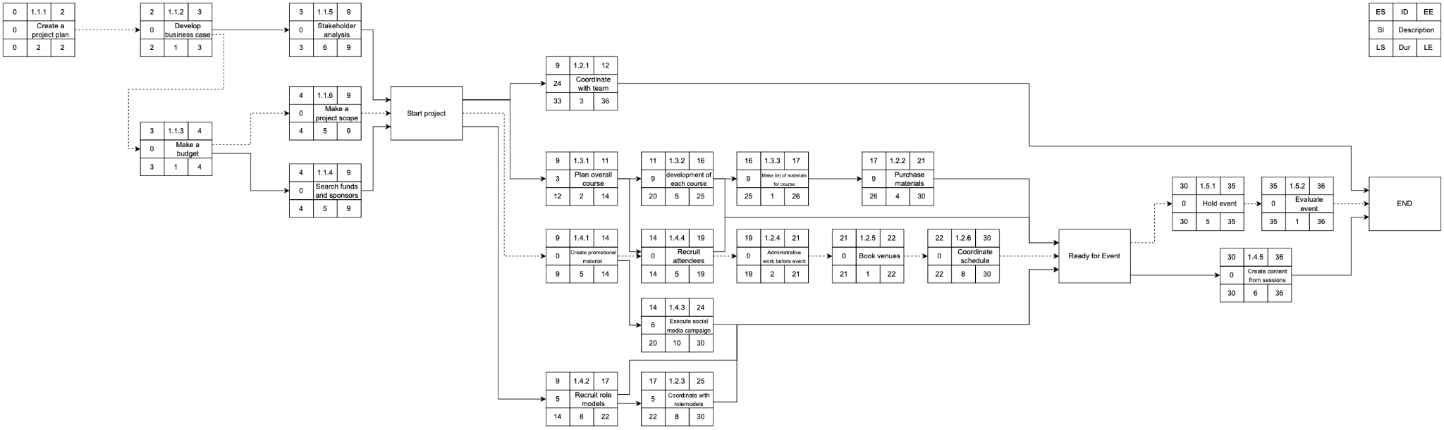
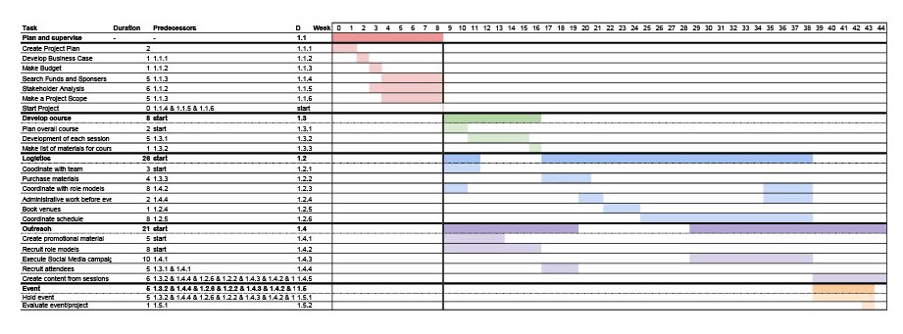
Schedule Management
WBS
RACI
From WHAT
HOW and WHEN
Gantt
AON
Notes:
After having defined WHAT the project should and should not include, the focus was set on HOW and WHEN each of these parts should be delivered.
This was carried out through the project schedule management by working on the processes required to manage the timely completion of the project.
As a part of this process, we used several different tools to first define and then structure the actual work of the project.
These tools included WBS, RACI, Gantt and AON, where the WBS and the RACI were especially beneficial for the project.

Slide 12
Schedule Management
WBS
RACI
Notes:
The Work Breakdown Structure was used to help break down the overall objective into smaller more manageable tasks in a hierarchical set up, making it easier to manage and control the complete project. In principle, we could have chosen to have more levels, but we found that these three levels were a good fit for a project of this format.
When the tasks were defined, we used the RACI to determine WHO would be in charge of and working with the different work packages. This tool was a crucial part in ensuring a clear assignment of responsibilities within the team.

Slide 13
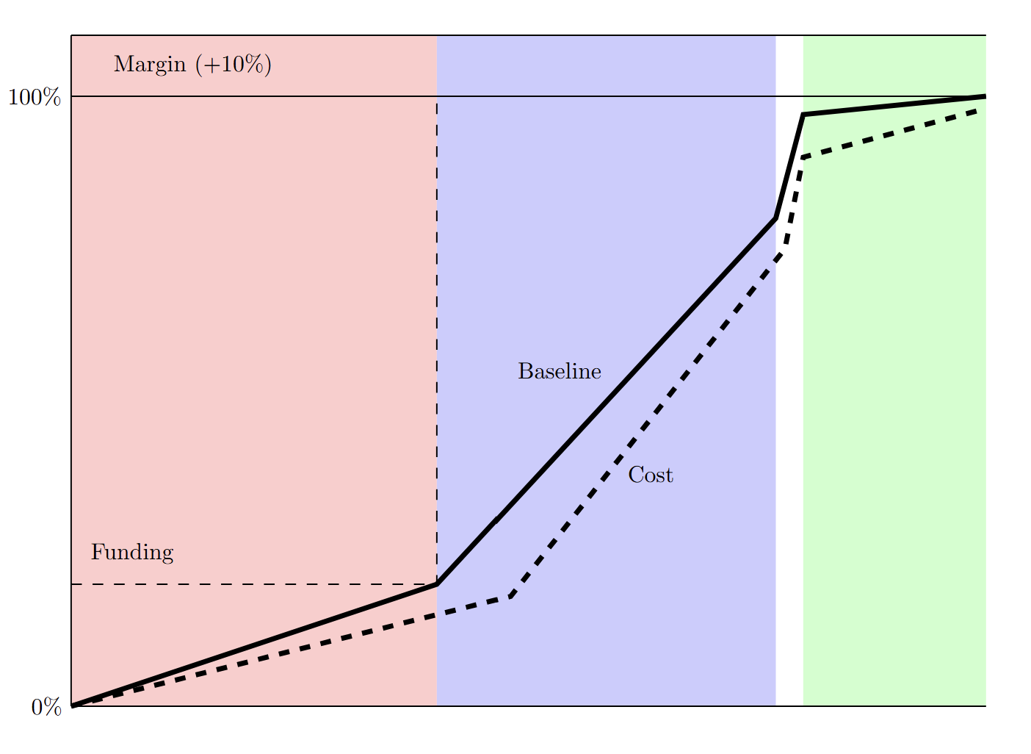
Cost Management
Top-down vs. Buttom-up:
12% discrepancy
Cost Baseline:
20% at initiation
80% upon approval
Cost Baseline

Slide 14
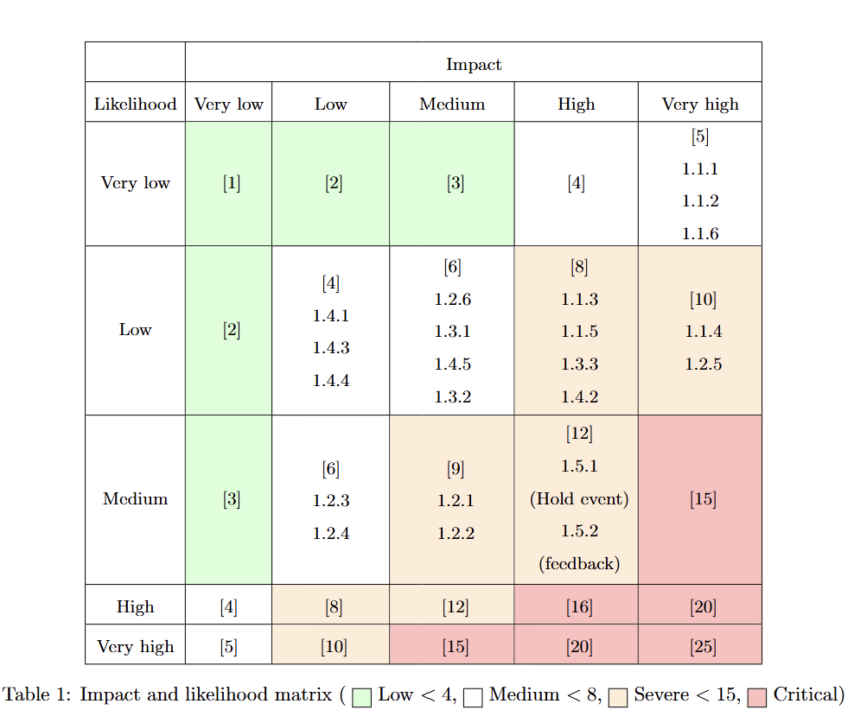
Risk Management
Impact & likelihood matrix
The event
Mitigation Strategy:
Backup role models
Adjusting event schedule or content

Slide 15
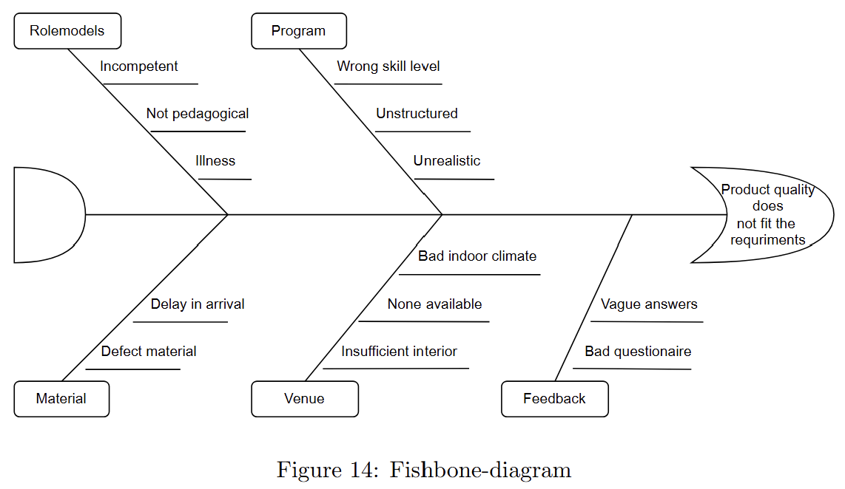
Quality Management
Feedback:
>80% positive
Cost of quality:
24.000 kr difference
Fishbone diagram

Slide 16
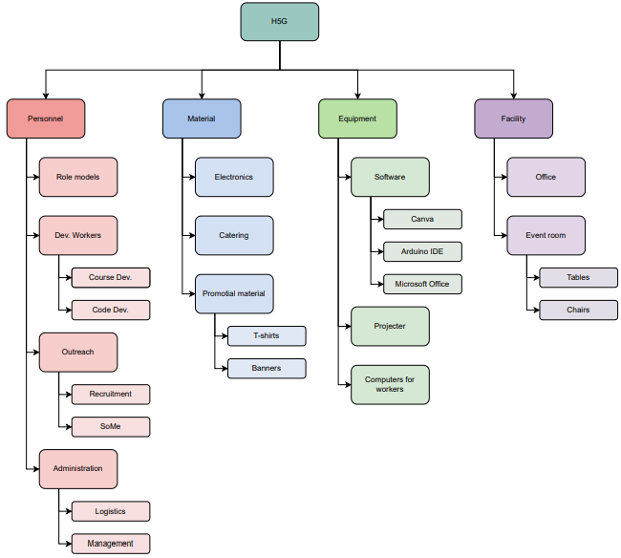
Resource
management
Types of resources:
Physical
Human
Resource Breakdown Structure(RBS)
Notes:
Christian

Slide 17
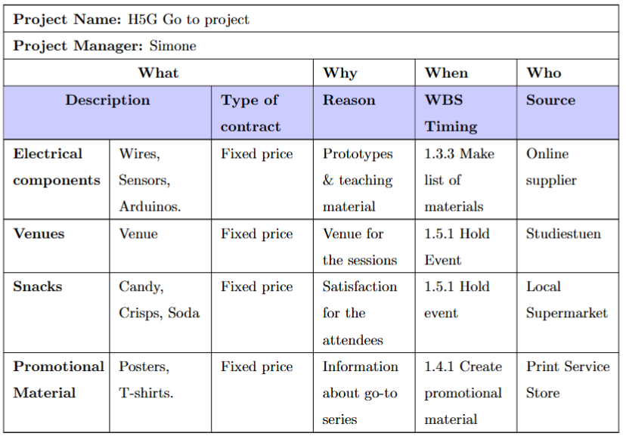
Procurement
Make or Buy analysis:
Buy
Risk sharing/transferring:
Fixed price contracts
Single sourcing
Snacks can be multiple sourcing
Procurement plan
Notes:
Christian

Slide 18
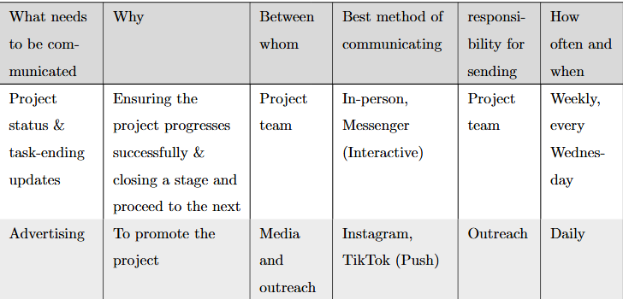
Communication Management
Enhances alignment & team collaboration
Reduces risks by misunderstanding
Communication Requirement Analysis
Stakeholder & Communication needs
Implementation
Communication plan

Slide 19
🔄 Reflection & Next Steps

Slide 20
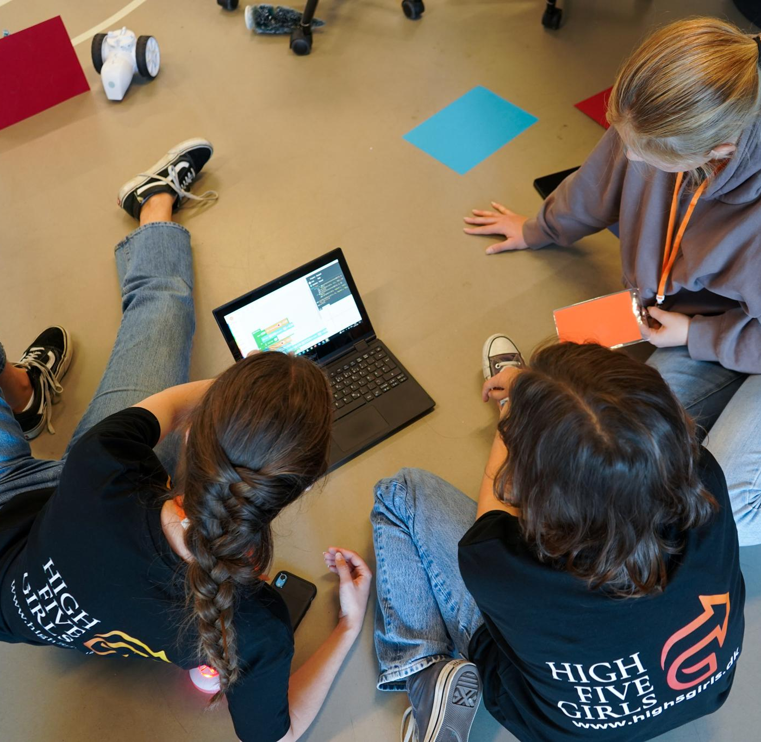
Project Reflection
Tool usage
Make-or-buy analysis
Work Breakdown Structure
Role usage
Many roles for simple project
Well defined roles
Future changes
Critical about the tools used
Notes:
Given the modest scope…limited value.
Calibrate the selection to the scale of the project.
We thought recruitment would be easy — but competition with sports and music clubs was stronger than expected. Next time, we’ll engage schools earlier and align events with school calendars.

Slide 21
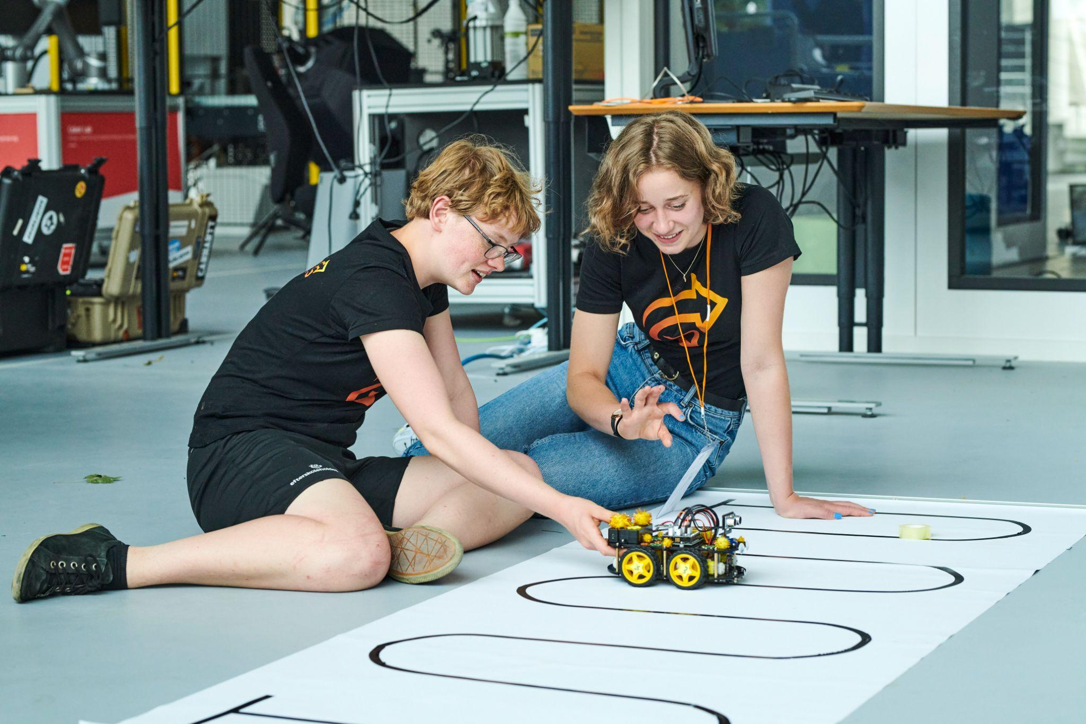
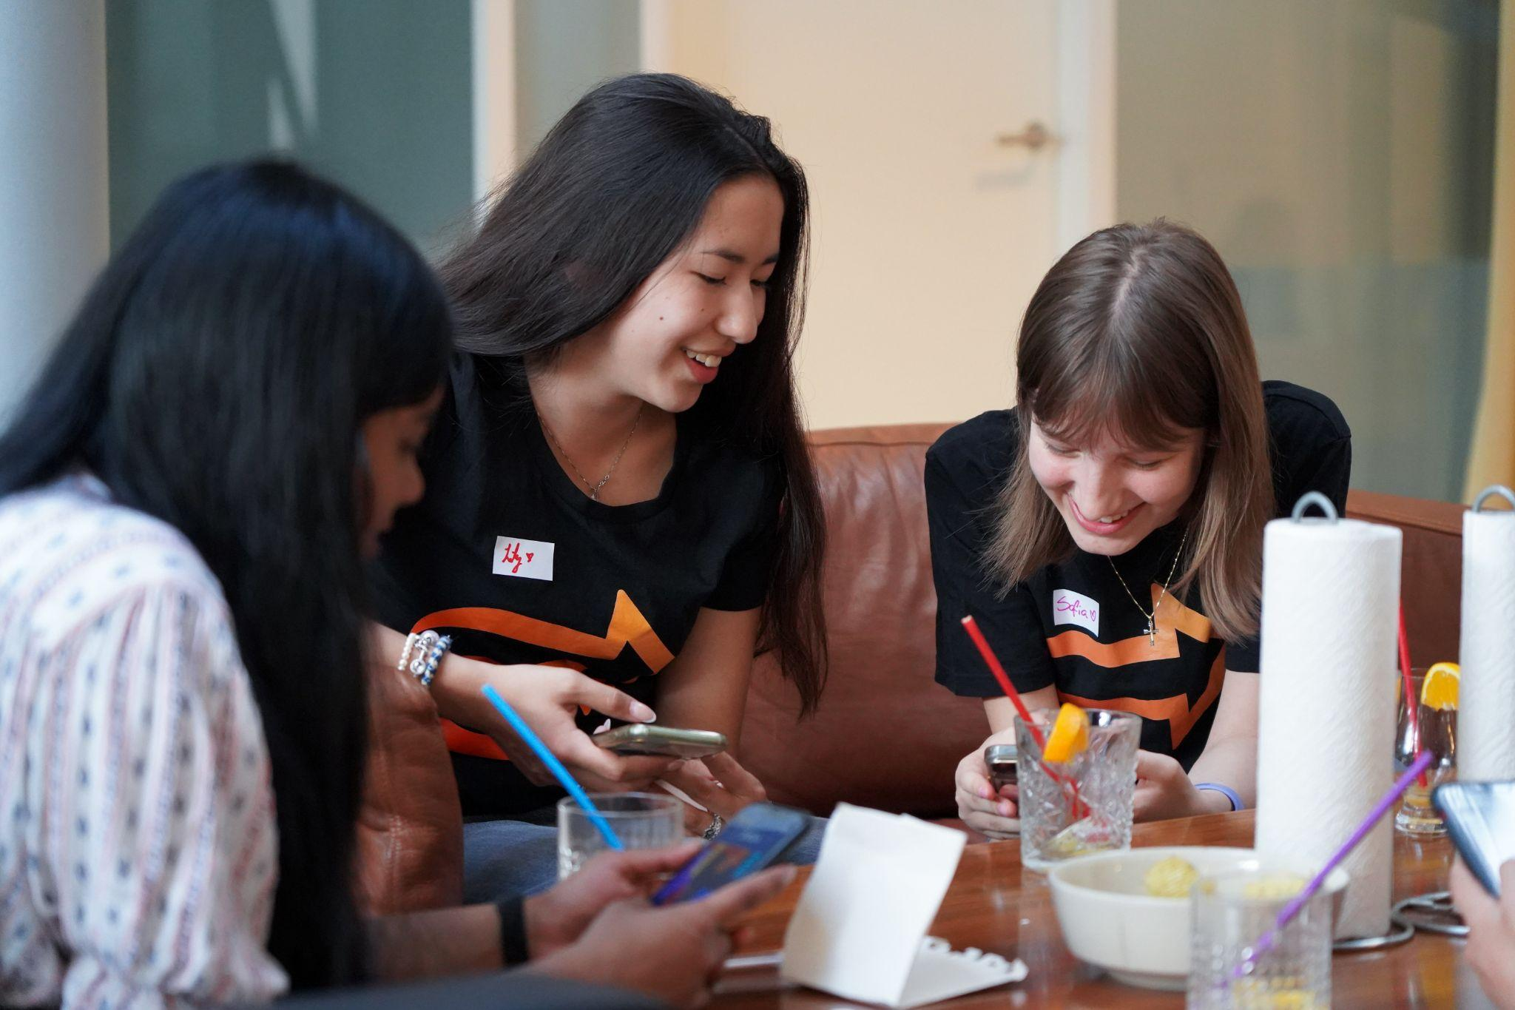
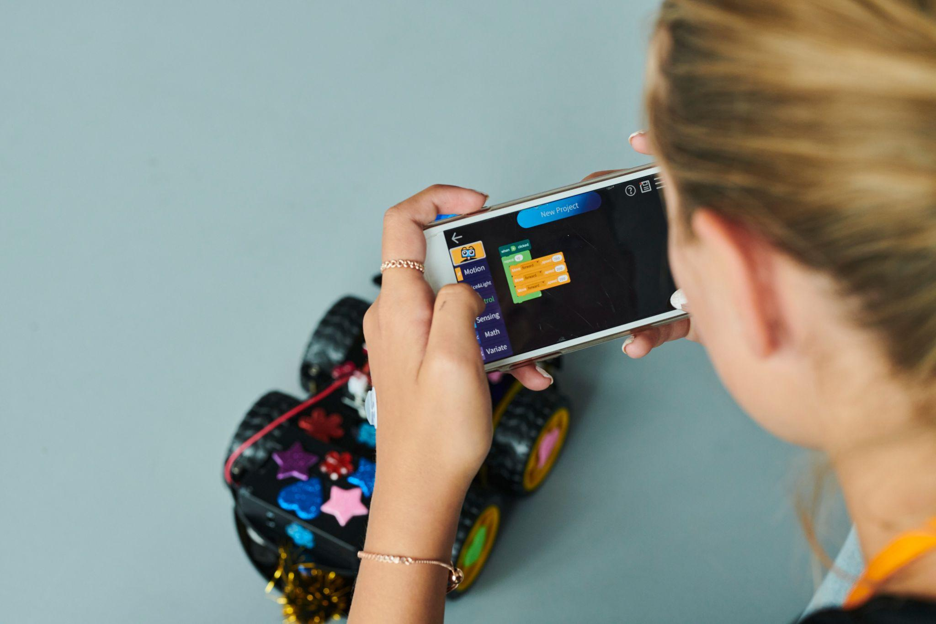
Questions?

